Slide 1

Information System of HDFC ltd
Presented to Prof Ajinkya Pol

Slide 2
Group Members
07
22
24
54
Adnan
Arif
Ashraf
Meeran

Slide 3
Flow of Presentation
Organizational structure used by HDFC
Input,Process, output
Core Banking System
Information system Solution used HDFC ltd
Level of Management

Slide 4
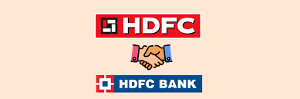
Introduction
HDFC was founded in 1977
HDFC offered a range of financial services
HDFC merged with HDFC Bank on July 1, 2023

Slide 5
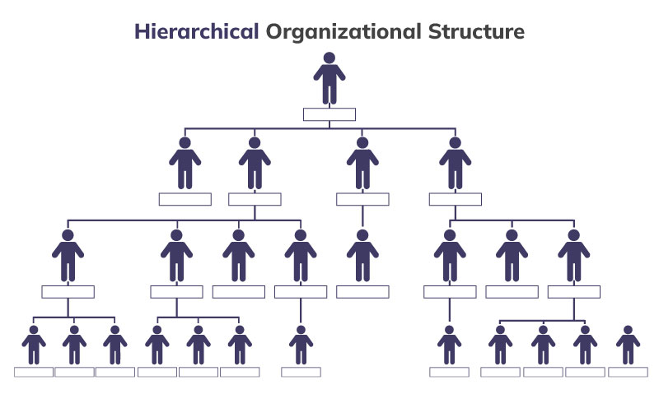
Organizational Structure

Slide 6
Core Banking System
Finware
Flexcube
Used for corporate banking,
Providing a robust platform for managing complex financial transactions.
Utilized for retail banking
Offering scalable and web-enabled solutions to enhance customer service and operational efficiency.

Slide 7
Level of Management
Top Level management
Includes the Chairman, Managing Director, and Chief Financial Officer
Middle Level management
Comprises General Managers and Department Heads
Lower level management
Consists of Team Leaders and Supervisors

Slide 8
Information System Solution
Executive Information Systems (EIS)
Transaction Processing Systems (TPS)
Management Information Systems (MIS)
·
Strategic information for decision-making.
Monitor performance and make tactical decisions
Handle day-to-day transactions

Slide 9
Top Level Management
Input
Output
Strategic data
Market trends
Financial reports
Strategic reports
Executive summaries
Dashboards
Process
Strategic planning
Forecasting
Data analysis

Slide 10
Middle Level Management
Input
Output
Operational data
Performance metrics
Budget reports
Departmental Performance reports
Summaries.
Process
Budgeting
Resource allocation
Performance analysis

Slide 11
Lower Level Management
Input
Output
Transactional data
Daily operational data
Transaction log
Operational reports
Daily summaries
Process
Transaction processing
Data entry
Record-keeping

Slide 12
Webliography
https://www.hdfcbank.com/
https://hdfc.com.mv/company-structure/
https://www.scribd.com/doc/208135135/HDFC-Bank-Organisation-Structure-Functional-Departments

Slide 13
Thank You

